Slide 1
STRINGS

Slide 2
COMPOUND DATA TYPE
Strings are qualitatively different from Integer and Float type.
Characters which collectively form a String is a Compound Data Type.
For Eg.
fruit = “apple”
letter = fruit[1]
print (letter)
Output : p // (index value starts from 0 as in C & C++)
index
0 | 1 | 2 | 3 | 4
a | p | p | l | e
-5 | -4 | -3 | -2 | -1

Slide 3
LENGTH OF STRINGS
The inbuilt function to find the length of a string is ‘len()’.
E.g..
fruit = “banana”
len(fruit)
Output : 6
To get the last letter we might try
length = len(fruit)
last = fruit[length] #ERROR
( because there is no character at 6th place)
0 | 1 | 2 | 3 | 4 | 5
b | a | n | a | n | a
-6 | -5 | -4 | -3 | -2 | -1

Slide 4
LENGTH OF STRINGS (to be continued…..)
Right Method to do this is :
length = len(fruit)
last = fruit[length-1]
Another way to get the elements from last is :
fruit[-1] # yields the last letter
fruit[-2] # yields the second last letter
0 | 1 | 2 | 3 | 4 | 5
b | a | n | a | n | a
-6 | -5 | -4 | -3 | -2 | -1

Slide 5
TRAVERSAL USING WHILE LOOP
Processing one character at one time.
For Eg.
index = 0
while index < len(fruit):
letter = fruit[index]
print (letter)
index = index + 1
(Take care of the indentation)
0 | 1 | 2 | 3 | 4 | 5
b | a | n | a | n | a
-6 | -5 | -4 | -3 | -2 | -1

Slide 6
TRAVERSAL USING FOR LOOP
For loop provides us a privilege to access the characters without using index.
For Eg.
fruit=“apple”
for ch in fruit:
print (ch)
(Each time through the loop a character is assigned to the variable char)

Slide 7
STRING SLICES
A segment of a string is called a slice.
The syntax to select a slice from a string is a[ n : m ], where a contains strings, n is the starting index and m is the end index.
Includes the first index and excluding the last index.
Eg:
s = “Peter, Paul, and Mary”
s[ 0 : 5 ] # Peter (index from 0 to 4)
s[ 7 : 11 ] # Paul
s[ 17 : 21 ] # Mary

Slide 8
STRING SLICES (to be continued…..)
fruit = “banana”
fruit[ : 3] #ban
fruit[ 3 :] #ana
fruit[:] ?
0 | 1 | 2 | 3 | 4 | 5
b | a | n | a | n | a
-6 | -5 | -4 | -3 | -2 | -1

Slide 9
Slicing with steps
String[ m : n : step ]
By default
m=0
n=len() – 1
step = 1
S = “Hello, world”
S[0 : 5 : 2 ]
Output ?

Slide 10
a. else b. elif c. for d. None of these
Quiz
break keyword is associated with

Slide 11
STRING COMPARISON
Equality Comparison
“banana” == “banana”
True
Other Comparisons
if “apple” < “banana”:
print ”apple comes before banana.”
else:
print ”apple comes after banana.”
“India”>=“india”
?
Note: Comparison of UNICODE of first mismatched character

Slide 12
STRING COMPARISON (to be continued…..)
> and < comparison operations are useful for putting words in alphabetical order:
Uppercase letters ,numerals and special symbol comes before Lowercase letters in Python.
Need to maintain a standard format of the strings.

Slide 13
STRINGS ARE IMMUTABLE
An existing string cannot be modified.
For Eg :
greeting = "Hello, world!“
greeting[0] = ’J’ # ERROR!
For Eg :
print (greeting)
Output : Hello, world

Slide 14
STRINGS ARE IMMUTABLE (to be continued….)
The Solution of the problem is
greeting = "Hello, world!“
newGreeting = ’J’ + greeting[1:]
print newGreeting
Output : Jello, World
The original string remains intact.

Slide 15
Creation of Find Function in Strings
The find() method finds the first occurrence of the specified value.
The find() method returns -1 if the value is not found.
string.find(value, start, end)
start and end are optional index values
Ex.
S=“I am Indian”
S.find(“di”)
Output
7
Python string rfind() method is similar to find(), except that search is performed from right to left.

Slide 16
Creation of Find Function in Strings
def myfind(st, ch):
index = 0
while index <= len(st) - 1:
if st[index] == ch:
return index
index = index + 1
return -1

Slide 17
a. parameters b. arguments c. keywords d. Data types
Quiz
def xymul(num1, num2):
return (num1*num2)
In this function num1 and num2 are known as

Slide 18
LOOPING AND COUNTING
The following code counts the number of times a appears in the string.
fruit = “grapes"
count = 0
for ch in fruit:
if ch == ’a’:
count = count + 1
print (count)
Output : 1

Slide 19
CHARACTER CLASSIFICATION
String module provides several constants that are useful for these purposes.
string.lowercase contains all the letters that the system considers to be lowercase.
string.uppercase contains all the letters that the system considers to be uppercase.
import string
print (string.ascii_lowercase)
print (string.ascii_uppercase)
print (string.digits)

Slide 20
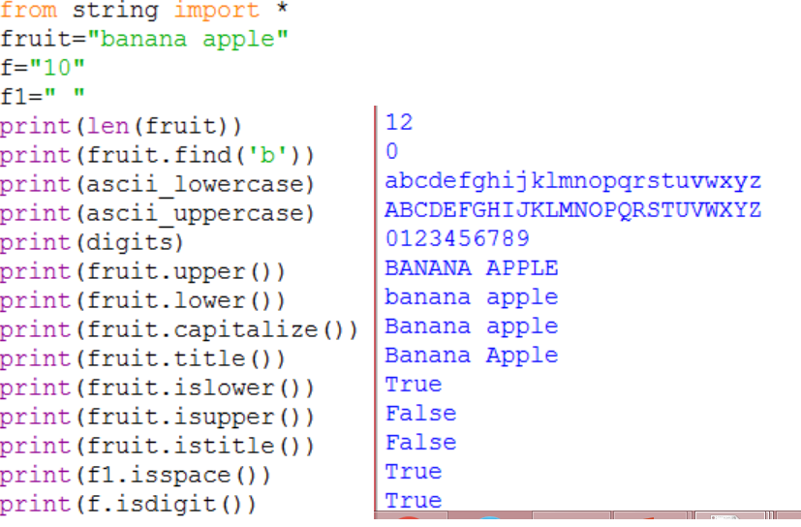
String Operations

Slide 21
How to find ASCII
>>>ord(‘a’)
Output 97
>>>char(97)
Output ‘a’

Slide 22
Assignment Questions:
Q1: Write a program in python to reverse a string.
Q2: Write a program in python to check whether a given string is palindrome or not.
Q3:Write a Python function that accepts a string and calculate the number of upper case letters and lower case letters. Sample String : 'The quick Brow Fox' Expected Output : No. of Upper case characters : 3 No. of Lower case Characters : 12

Slide 23
Q4:Write a Python function to check whether a string is pangram or not. Note : Pangrams are words or sentences containing every letter of the alphabet at least once. For example : "The quick brown fox jumps over the lazy dog" Q5: Write a python program to count the occurrence(frequency) of a particular character in a string.
Q6:Write a Python program to get a string made of the first 2 and the last 2 chars from a given a string. If the string length is less than 2, return instead of the empty string. Sample String : 'wakawama' Expected Result : 'wama' Sample String : 'wa' Expected Result : 'wawa' Sample String : ' w' Expected Result : Empty String

Slide 24
Q7:Write a Python program to add 'ing' at the end of a given string (length should be at least 3). If the given string already ends with 'ing' then add ‘EE' instead. If the string length of the given string is less than 3, leave it unchanged.
Sample String : 'abc' Expected Result : 'abcing' Sample String : 'string' Expected Result : 'stringEE‘
Q8: Write a Python program to find the first appearance of the substring 'not' and 'poor' from a given string, if 'bad' follows the 'poor', replace the whole 'not'...'poor' substring with 'good'. Return the resulting string.
Sample String : 'The lyrics is not that poor!' Expected Result : 'The lyrics is good!'

Slide 25
Q10: Write a Python program to get a string from a given string where all occurrences of its first char have been changed to '$', except the first char itself.
Sample String : 'restart' Expected Result : 'resta$t’

